Slide 1
AUTOMATED SOLAR WATER PUMPING SYSTEM
NAME : TEAM SHADOW
TEAM ID : 135

Slide 2

In the present world, due to depleting conventional energy resources and increased amounts of pollution, we need to promote clean and green energy sources. This has to start from basic house-hold needs and then extended to large-scale industrial purposes.

Slide 3
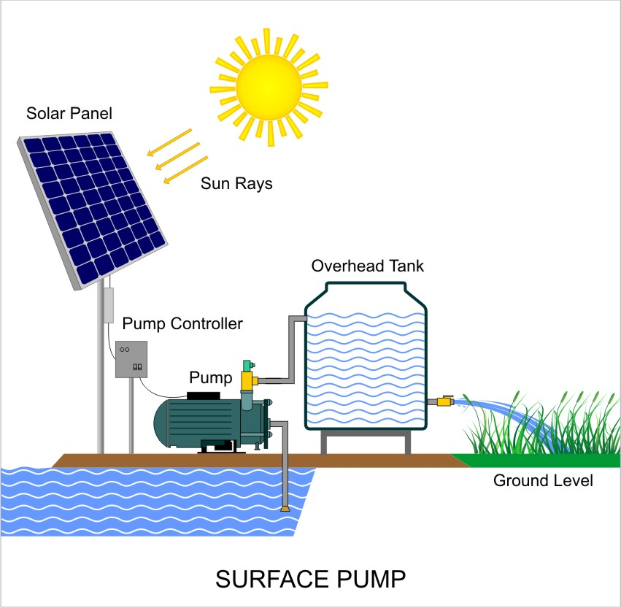
Problem Statement
To build a model of water pumping system run on solar power which can be operated using serial communication

Slide 4
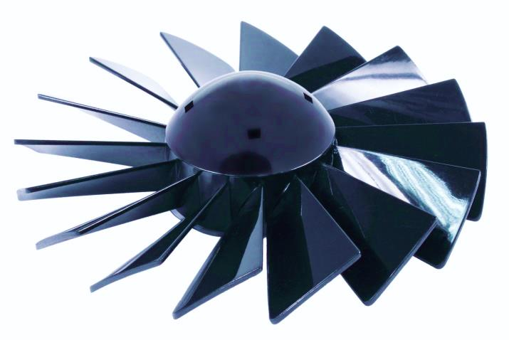
As per the planned schedule, the first two weeks were spent for understanding of solar power systems and associating them to run a water pumping system and we arrived at a following points :
Design of the pumping system :
The pumping system can be made using a 12V DC motor and a self-designed impeller (printed using solid works).
There are two possible types for the motor - submersible and surface. We intend to make it the surface type.
It requires sealing the apparatus and making it airtight.

Slide 5
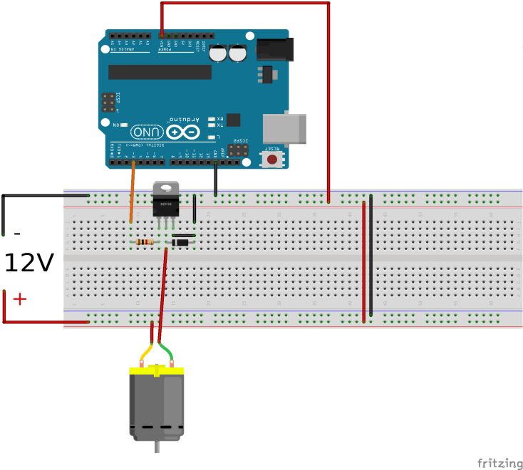
Controlling the system :
To automate the pumping system, we intend to use an Arduino. But the arduino can only operate through 5V and so we will have to use relays to control higher voltage circuits.

Slide 6
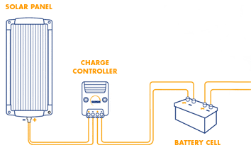
Solar power system :
Coming to the issue of solar power, we initially planned to assemble a solar panel by connecting the solar cells in series. But this idea was later discarded.
We will buy a solar panel of 12V 20W and store it's energy in a battery. The energy in the battery will be routed through the arduino and then to the motor to run it.

Slide 7
Future Work :
Firstly we will design the impeller with optimal structure.
We will simultaneously work on completing the circuit using relays/transistors.
The solar panel will be then connected to the battery and first we will test the working of motor without the arduino.
Then coding part of the project will be started. We will sequentially operate the motor – first by serial communication and then using wireless modules.

Slide 8
Parts required :
Solar Panel
Battery
Arduino
Relay/Transistor
DC Motor
Impeller

Slide 9
THANK YOU !!!

